Slide 1
The Real ORNL Automotive Dynamometer Controller Area Network Intrusion Detection Dataset
Hifza M.Anwar - 63110
Supervised By:
Dr.Salman Khan

Slide 2
About Dataset
First I saw the size of each dataset and found that our data is huge. In ambient datasets, we have different datasets all of the data sizes in ambient is about 1 to 3 million records which can not easily implement , for that we need more computational resources. I tried to divide datasets into chunks and then applied algorithms on that chunks but it took too much time for computational so that’s why according to sir’s advice I moved towards attacks datasets, here also we have different types of attacks datasets with huge records. I selected fuzzing and max coolant attack data set first .

Slide 3
As I selected first fuzzing attacks because all the other datasets size was very huge and they need more computational resources to run algorithms .
Fuzzing attack further categorized into.
Fuzzingattack_1
Fuzzingattack_2
Fuzzingattack_3
After selecting this dataset first I have done data preprocessing as the data
was uncleaned and need to be done preprocessing.I convert the dataset into different columns because all the data was in a column after splitting the datasets into different columns. furthermore, I converted the data of ID and Hex data in decimal which was in hexadecimal.after doing this I implemented different classification algorithms and checked accuracy.

Slide 4
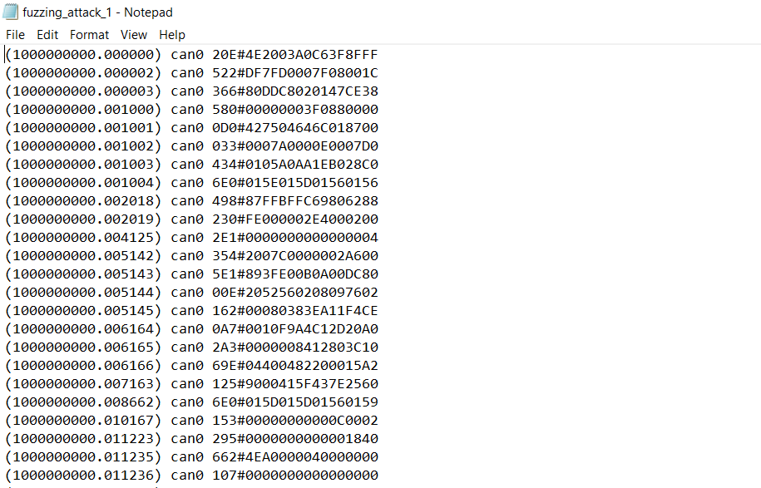
DataSet: Fuzzing attack 1

Slide 5
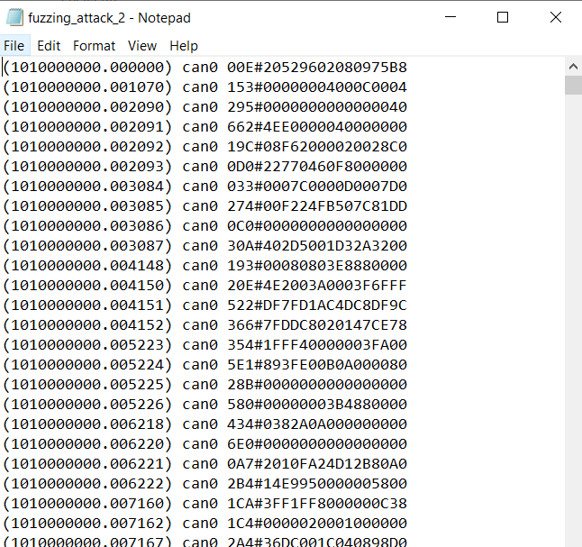
Fuzzing attack_2

Slide 6
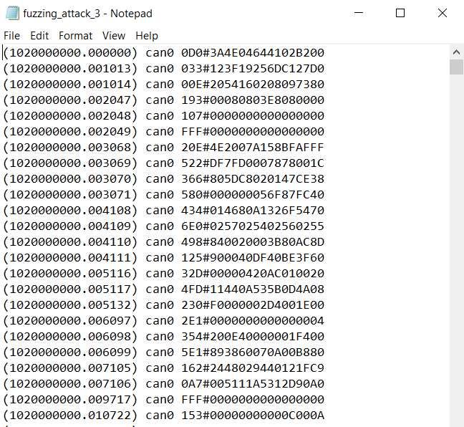
Fuzzing attack_3

Slide 7
Dataset and Algorithms Selection:
After finalizing the dataset with the help of sir , the next phase was implementation of algorithms

Slide 8
01
KNN
02
Decision Tree
03
04
Random Forest
SVM
Algorithms Used

Slide 9
90%
58%
57%
20%
KNN achieved the highest accuracy for fuzzing_attack_1
KNN
DT
RF
SVM

Slide 10
79%
60%
60%
20%
KNN achieved the highest accuracy for fuzzing_attack_2
KNN
DT
RF
SVM

Slide 11
76%
65%
55%
20%
KNN achieved the highest accuracy for fuzzing_attack_3
KNN
DT
RF
SVM

Slide 12
It was created after all training and testing of algorithms on the dataset
OBSERVATION
PARAMETERIZATION
CROSS VALIDATION
GRID SEARCH
Without hyperparameter tuning
With hyperparameter tuning feature selection
Using k folds cross validation
Using grid of parameters combinations

Slide 13
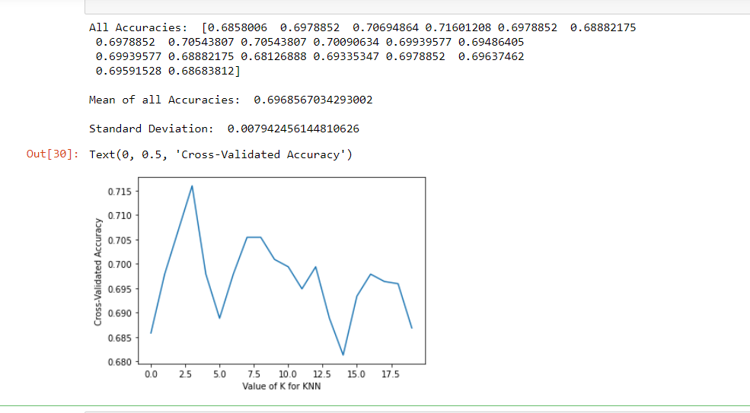
Visualization by graph
As I had implement algorithms, so then I created the graph to show accuracy .This is the graph of KNN algorithm for fuzzing attack 3 dataset. As here can see that the accuracy is lying under 68 to 70% after hyper parameter tuning.

Slide 14
Visualization by graph
As I had implement algorithms, so then I created the graph to show accuracy .This is the graph of KNN algorithm for fuzzing attack 2 dataset. As here can see that the accuracy is lying under 76% after hyper parameter tuning.

Slide 15
Visualization by graph
As I had implement algorithms, so then I created the graph to show accuracy .This is the graph of KNN algorithm for fuzzing attack 1 dataset. As here can see that the accuracy is lying under 79% after hyper parameter tuning.

Slide 16
Conclusion
After fuzzing attack I moved with max coolant attacks and did the same with coolant attacks too ,From these research and results, I can conclude that only Knn algorithms (K nearest neighbour) work exceptionally well on the dataset while on the other hand remaining three algorithms (SVM ,Decision Tree and Random Forest )are not working well as they only give 50% accuracy even after applying hyper parameters tuning and took too much time for implementation .So, I can say that KNN is good for our dataset.and we will work with KNN for future implementation.

Slide 17
FUTURE WORK
In this work we are presenting comprehensive survey of publicly available CAN intrusion datasets. Based on a thorough analysis of the data and documentation, for each dataset we will provide a detailed description and enumerate the drawbacks, benefits, and suggested use cases. Our analysis is aimed at guiding researchers in finding appropriate datasets for testing a CAN IDS.
Will work for other datasets which are remaining .
Come up with proper computational resources.
Will suggest best Algorithm.
Will publish our research work.

Slide 18


THANKYOU

